Slide 1
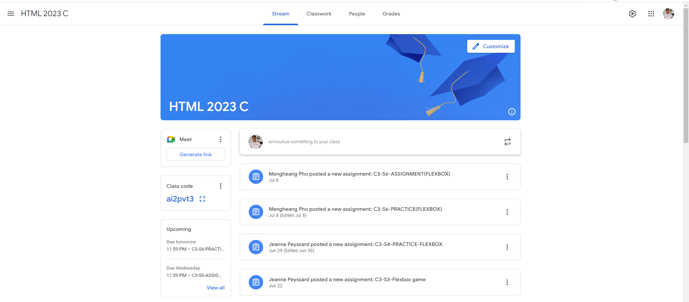
Identify root components of website below

Slide 2
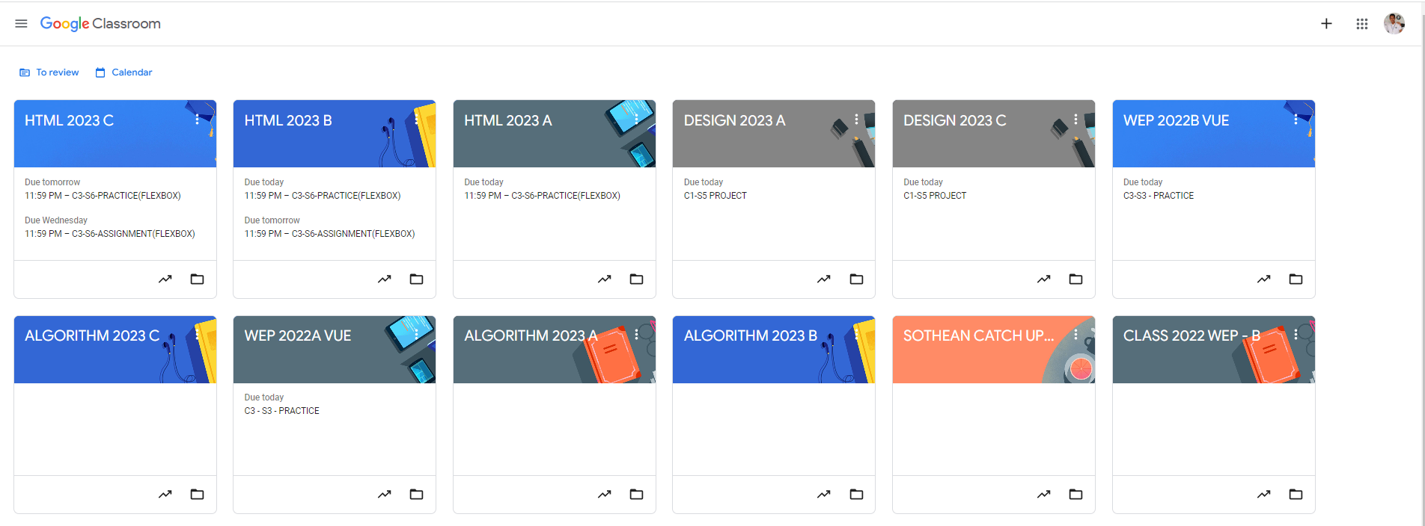
Root div
- Height: 100vh
content
nav
Flex: 0
header
Flex: 0
Flex: 1

Slide 3
nav
header
content

Slide 4
content
div container
flex-direction: row
left div
right div

Slide 5
container
flex-direction: column
div
div
div

Slide 6
container
flex-direction: column
div
div
div
div
div

